Slide 1
BPL Governance & Development Committee
John Hailer, Committee Chair
5.17.24
Members of the Public may sign up for Public Comment via the CHAT by 4:30 p.m.
Comments left in the chat will not be acknowledged. written comments may be submitted to the Clerk of the Board, pcarver@bpl.org

Slide 2
BPL Opening Statement
The Trustees of The Boston Public Library reaffirm our commitment to racial equity and to principles of diversity equity and inclusion, more broadly.
The Library is formally committed to becoming an anti-racist organization in response to systemic racism, inequity, and injustice prevalent in our society.
We acknowledge also that the Boston Public Library’s Central Library stands on land that was once a water-based ecosystem providing sustenance for the indigenous Massachusetts people and is a place which has long served as a site of meeting and exchange among nations. We are committed to land acknowledgements for all locations at which we operate.
We reaffirm this commitment to set the context for our planning, deliberations, and public engagement so that they take place from the spirit of welcome and respect, found in our motto ‘free to all.’
Taken from the Institutional Statement Ratified by the Board of Trustees for the Boston Public Library on September 29, 2020.

Slide 3
G&D Committee
John Hailer, Committee Chair
Welcome remarks
Roll Call
Approval of Meeting Minutes from May 22, 2023

Slide 4
Nomination and Vote for the Officers for the Board of Trustees
John Hailer, Committee Chair
Dr. Ray Liu, Chair
Evelyn Arana Ortiz, Vice Chair
Pamela Carver, Clerk
VOTED: “that, the Trustees Governance and Development Committee recommend the Trustees of the Public Library of the City of Boston approve the nomination for the slate of officers for the Board of Trustees of the Public Library of the City of Boston at the Annual Trustees Meeting on May 21, 2024 for a 1-year term beginning July 1, 2024 including: Dr. Ray Liu as Chair, Evelyn Arana Ortiz as Vice Chair, and Pamela Carver as Clerk.”

Slide 5
Update of 2024 Trustees
Reappointment of Jeffrey Hawkins
Chair of the BPL Fund Board
Holdover status of Chynah Tyler State Representative
Appointment of Jonathan Lavine Chair of Bain Capital

Slide 6
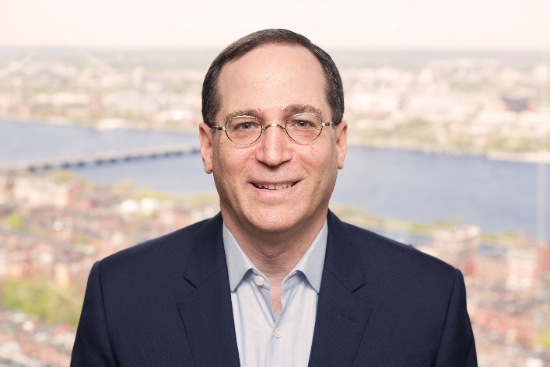
Jonathan Lavine is Chair of Bain Capital, a leading global private investment firm with approximately $185 billion in assets under management, more than 1,750 employees and 25 offices worldwide. Mr. Lavine founded Bain Capital Credit, formerly known as Sankaty Advisors, in 1998 Mr. Lavine and his wife, Jeannie, formed and oversee the Crimson Lion Foundation which delivers financial resources to a wide variety of nonprofit organizations focused on leveling the playing field for individuals and families. The foundation works to address pressing social challenges in the areas of education, community and public service, health and welfare, discrimination, and poverty. It supports the multi-disciplinary efforts of organizations that serve to strengthen society through research, innovation, public policy, direct service and advocacy. Mr. Lavine is the 2017 recipient of Columbia University’s Alexander Hamilton Medal, the highest honor awarded to a member of the college community for distinguished service. Mr. Lavine was appointed a Member of the United States Holocaust Memorial Museum Council by President Obama and reappointed by President Biden. He is also a member of the investor group and a director of the Boston Celtics. Mr. Lavine graduated from Columbia College, Phi Beta Kappa and Magna Cum Laude, and holds an M.B.A with Distinction from Harvard Business School. He received an Honorary Doctor of Laws degree from Columbia University in 2023.
Jonathan S. Lavine

Slide 7
New Business
John Hailer, Committee Chair

Slide 8
Public Comment
If follow up is required, please send your contact email or phone number to the Clerk of the Board at
pcarver@bpl.org
People will be chosen in the order they were received and allowed 2 minutes to speak.
The Moderator will unmute your mic when you are called on.
Comments made in chat during meeting will not be acknowledged.

